Slide 1
Git
Distributed Version Control System

Slide 2
Distributed Version Control Systems
  Similar to traditional/centralized VCS systems
  Main difference is each committer has a local repository
  Committer commits changes to local repo as they work
  Changes in local repo are "pushed" to remote repos in order to share changes with team.
  Merging is an integral part of the process due to local and remote repo operations

Slide 3
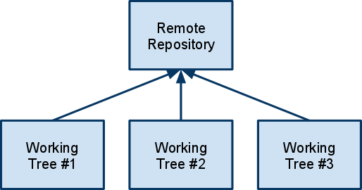
Traditional/Centralized VCS

Slide 4
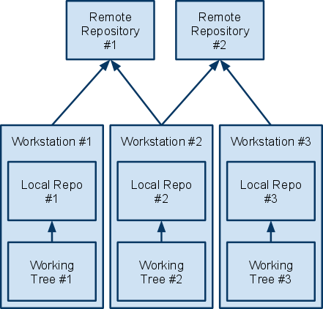
Distributed VCS

Slide 5
Benefits of DVCS
Benefits of all DVCS systems from Wikipedia:
  Allows users to work productively even when not connected to a network
  Makes most operations much faster since no network is involved
  Allows participation in projects without requiring permissions from project authorities, instead of requiring "committer" status
  Allows private work, so users can use their revision control system even for early drafts they do not want to publish
  Avoids relying on a single physical machine as a single point of failure.
  Still permits centralized control of the "release version" of the project

Slide 6
What is Git?
From the Git website:
Git is a free & open source, distributed version control system designed to handle everything from small to very large projects with speed and efficiency.
Every Git clone is a full-fledged repository with complete history and full revision tracking capabilities, not dependent on network access or a central server. Branching and merging are fast and easy to do.
  Initially designed and developed by Linus Torvalds for Linux kernel development.
  Used by many major open source projects such as Android, Eclipse and Ruby on Rails

Slide 7
Benefits of Git
  Merging is essential to the workflow and therefore, it is fast and tends to have far fewer conflicts than SVN
  Managing branches is easy and switching between them locally is fast
  Subversion integration built-in for importing and/or pushing back to SVN repo

Slide 8
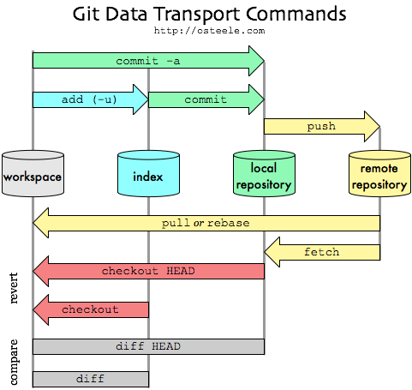
Overview of Git Workflow/Commands

Slide 9
Stage and Commit
  Git has concepts of staging and committing files.
  Staging a file/directory tells Git you want to track the file.
  Once staged, a file can be committed to the local repo.
Stage and Commit
prompt> git add <some file>
prompt> git commit -m "Some message"
Commit, skip Stage
prompt> git commit -m "Some message" -a

Slide 10
Pull/Fetch
  Fetch pulls changes from the remote repository to the local repository
  Fetch does not merge the changes into the working tree. You need to merge the changes into the working tree.
  Pull combines the fetch and the merge.
Fetch
prompt> git fetch <remote name>
Pull
prompt> git pull <remote name>

Slide 11
Push
  Push sends the changes in your local repo up to the remote repository
  It is required that you first do a pull to merge changes in the remote repo into your local repo
Push
prompt> git push <remote name> <branch name>

Slide 12
Branch/Checkout
  Many ways to create a new branch
  Creating a branch does not switch your context to it. This is a checkout.
Branch
prompt> git branch <new branch name>
Checkout
prompt> git checkout <branch>
Branch and Checkout
prompt> git checkout -b <branch>
View all Branches
prompt> git branch

Slide 13
Tag
Tagging marks a milestone in the life of project. Similar to tagging in other VCS systems. Git makes all tags read-only.
Create Tag
prompt> git tag name
List all tags
prompt> git tag

Slide 14
Syncing with Subversion
Git allows you to use git locally and use SVN as a remote repository.
Create Git clone of Subversion repo
prompt> git svn clone -s svn://example.com/repo
Update from SVN
prompt> git svn rebase
Commit to SVN
prompt> git svn dcommit

Slide 15
Typical Development Workflow
Develop on Trunk
prompt> git clone git://some-repo
... or ...
prompt> git pull
Modify Code
prompt> git commit -a -m "message"
prompt> git pull
prompt> git push

Slide 16
Typical Development Workflow
Develop on new Feature Branch branched from Trunk
prompt> git checkout -b <new branch name>
... or ...
prompt> git branch <new branch name>
prompt> git checkout <new branch name>
prompt> git push <server name> <new branch name>
Modify Code
prompt> git commit -a -m "message"
prompt> git merge origin
prompt> git pull
prompt> git push
Resolve Conflicts
prompt> git checkout master
prompt> git merge <new branch name>
prompt> git pull
prompt> git push
prompt> git branch -d <new branch name>
prompt> git push origin :<new branch name>

Slide 17
Tooling
  TortoiseGit (Windows) is a port of TortoiseSVN
  Gitty (Mac) – Full featured, open source Mac OS X client.
  EGit is an Eclipse Team Provider for an integrated IDE experience
  Supported by most major CI servers

Slide 18
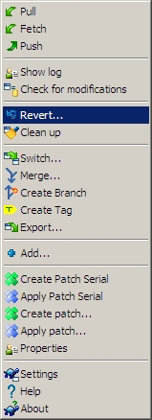
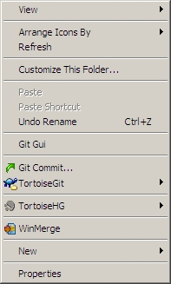
Tortoise Git

Slide 19
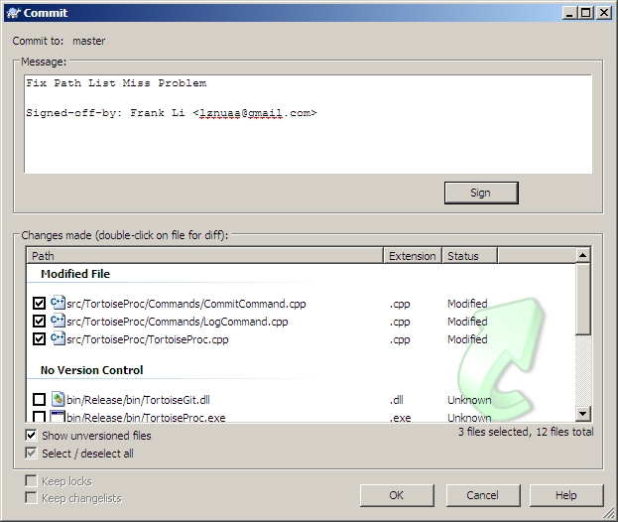
Tortoise Git

Slide 20
Resources
  http://gitscm.com/
  http://en.wikipedia.org/wiki/Distributed_version_control
  http://code.google.com/p/tortoisegit/
  http://osteele.com/archives/2008/05/my-git-workflow
  Pragmatic Guide to Git - Travis Swicegood

